Slide 1

Analyzing
Amazon Sales
Data

Slide 2

Agenda
Introduction
Sample Data
Main KPIs
Dashboard
Key Findings

Slide 3
Amazon Sales
Amazon is a global leader in e-commerce, with sales spanning numerous countries.
Its vast reach and diverse product offerings have reshaped retail, impacting consumer behavior and setting trends. Amazon's sales volumes reflect its pivotal role in the digital economy, influencing supply chains and logistics worldwide.
Amazon's e-commerce sales fluctuate significantly month to month, influenced by seasonal trends, promotional events like Prime Day, and global economic conditions.
Monthly sales figures can vary from billions to tens of billions of dollars, reflecting its vast product range and customer base.

Slide 4
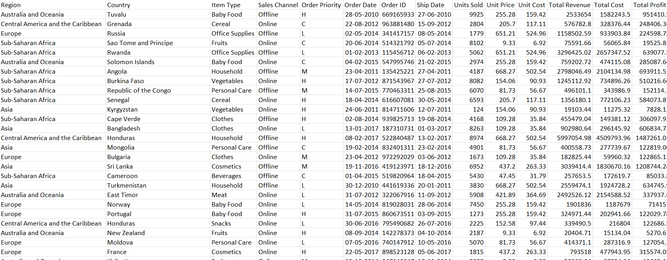
DATA

Slide 5
Main KPIs
Total Revenue Generated
Total Profit Generated
Total Unit Sales

Slide 6
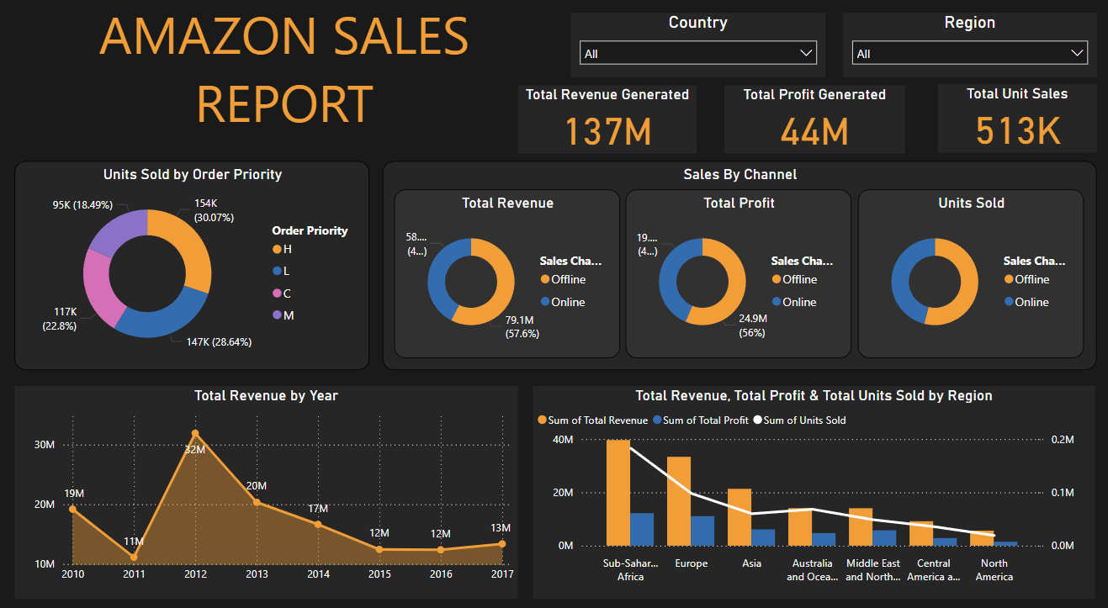
DASHBOARD

Slide 7
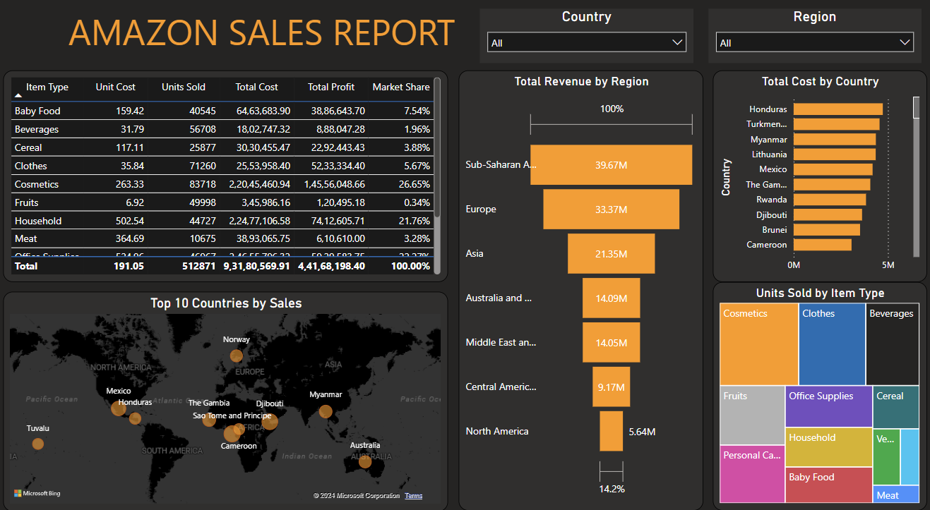
DASHBOARD

Slide 8
Key Findings
  Year 2012 had the highest revenue i.e. 31.8M.
  Sale is more driven through offline channel.
  Sub-Saharan Region drives more revenue than other regions.
  Cosmetics is the bestseller item type among others.

Slide 9
Thank you
Vedant Burande
vedd.exe@gmail.com

